Slide 1
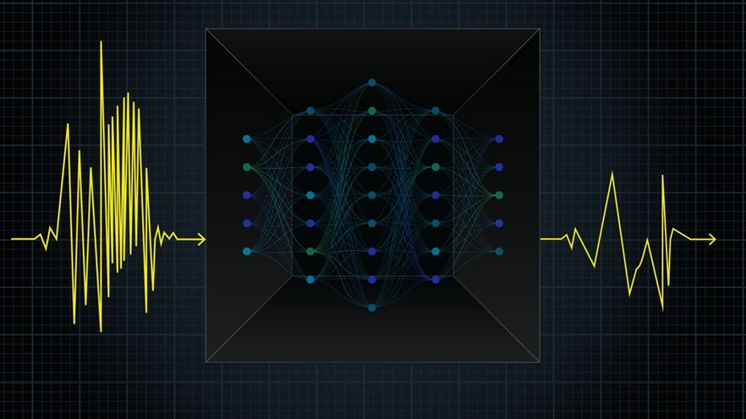
GEOL593: Seismology and Earth Structure, Spring 2023
Lecture 12: Machine Learning in Seismology

Slide 2
Class schedule
 | Dates | Topic | Lab assignment
Week 1: | Jan 17, Jan 19 | Course overview | Lab 1: Python crash course
Week 2: | Jan 24, Jan 26 | Seismic signal processing | Lab 2: Introduction to Obspy
Week 3: | Jan 31, Feb 2 | Moment Tensors/ Inverse methods | Lab 3: Moment tensor inversion
Week 4: | Feb 7, Feb 9 | 🤮 No class, Ross ill | Seismic wave propagation 1
Week 5: | Feb 14, Feb 16 | Lab 4: Reference Earth models: The “1D” Earth | Seismic wave propagation 2
Week 6: | Feb 21, Feb 23 | Lab 5: Surface wave dispersion | Surface waves and normal modes
Week 7: | Feb 28, Mar 2 | Lab 6: Normal modes | Imaging Earth Structure 1: Seismic tomography
Week 8: | Mar 7, Mar 9 | Lab 7: Seismic Tomography | Imaging Earth Structure 2: Seismic discontinuities / Research paper discussion
Week 9: |  | Spring break
Week 10: | Mar 21, Mar 23 | Lab 8. Receiver Functions | Anisotropy and anelasticity
Week 11: | Mar 28, Mar 30 | Planetary seismology 1 | Lab 9: InSight- Seismology on Mars
Week 12: | Apr 4, Apr 6 | Planetary seismology 2
Week 13: | Apr 11, Apr 13 | Machine learning in seismology 1 | Lab 10: Earthquake detection
Week 14: | Apr 18, Apr 20 | Machine learning in seismology 2
Week 15: | Apr 25, Apr 27 | Frontiers of seismology: What’s next?
Week 16: | May 2, May 4 | Research paper presentations

Slide 3
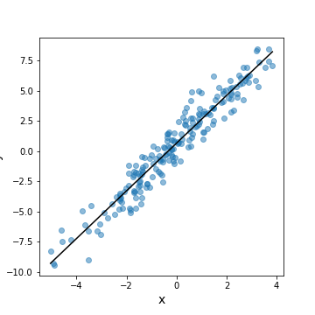
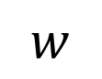
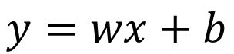
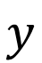
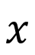
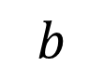
Linear regression with a neural network
$$y=wx+b$$
Input layer
Output layer
$$b$$
$$w$$
$$x$$
$$y$$
x = ‘features’
y = ‘labels’
w = ‘weight’
b = ‘bias’

Slide 4
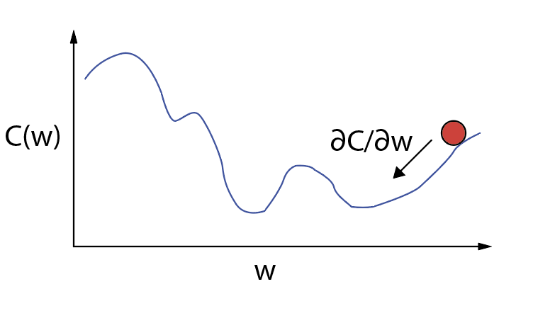
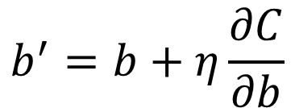
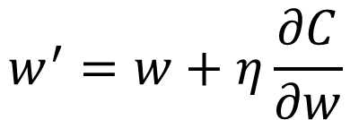
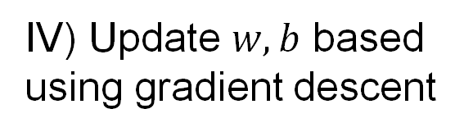
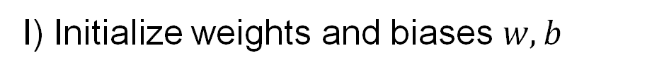
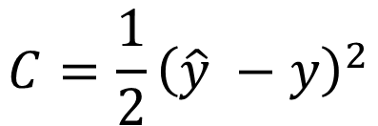
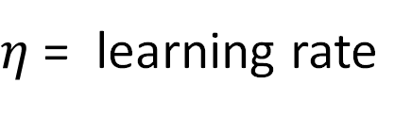
Linear regression with a neural network
Training our network
$$y=wx+b$$
I) Initialize weights and biases $w,b$
$$C=\frac{1}{2}{\left(\hat{y} −y\right)}^{2}$$
Input layer
Output layer
II) Define cost function
$$b$$
$$w$$
$$y$$
III) Loop over training data
and calculate loss
$$x$$
$$w^{′}=w+η\frac{∂C}{∂w}$$
gradient descent
IV) Update $w,b$ based
using gradient descent
$$b^{′}=b+η\frac{∂C}{∂b}$$
$η$ = learning rate

Slide 5
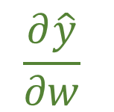
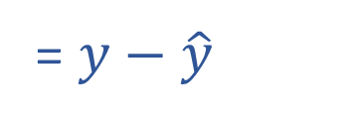
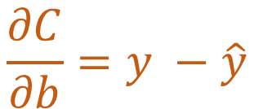

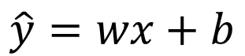
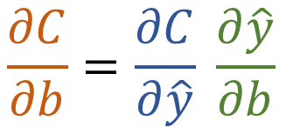
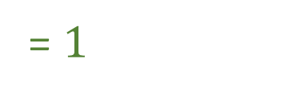
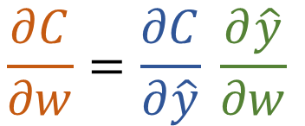
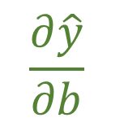
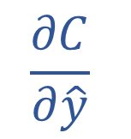
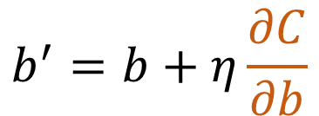
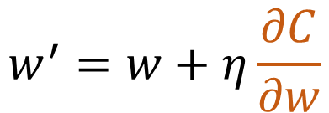
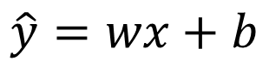
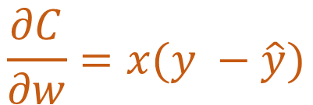
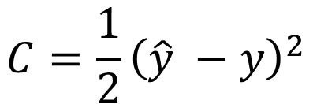
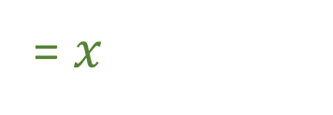

Linear regression with a neural network
$$w^{′}=w+η\frac{∂C}{∂w}$$
$$b^{′}=b+η\frac{∂C}{∂b}$$
$$\frac{∂C}{∂w}=\frac{∂C}{∂\hat{y}} \frac{∂\hat{y}}{∂w}$$
$$\frac{∂C}{∂b}=\frac{∂C}{∂\hat{y}} \frac{∂\hat{y}}{∂b}$$
$$C=\frac{1}{2}{\left(\hat{y} −y\right)}^{2}$$
$$\frac{∂C}{∂\hat{y}}$$
$$\frac{∂C}{∂\hat{y}}$$
= $y−\hat{y}$
= $y−\hat{y}$
$$\frac{∂\hat{y}}{∂w}$$
$$\frac{∂\hat{y}}{∂b}$$
$$\hat{y}=wx+b$$
= $x$
$$\hat{y}=wx+b$$
= $1$
$$\frac{∂C}{∂w}=x(y −\hat{y})$$
$$\frac{∂C}{∂b}=y −\hat{y}$$

Slide 6
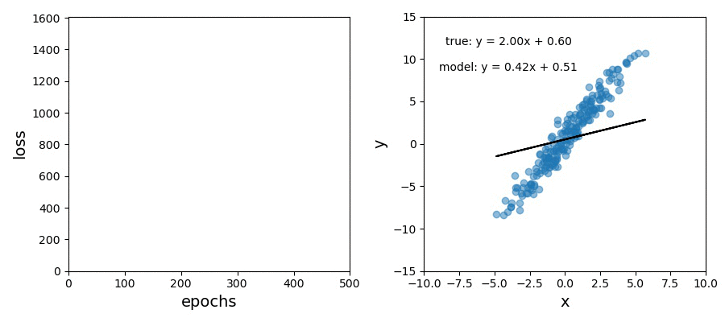
Linear regression with a neural network

Slide 7
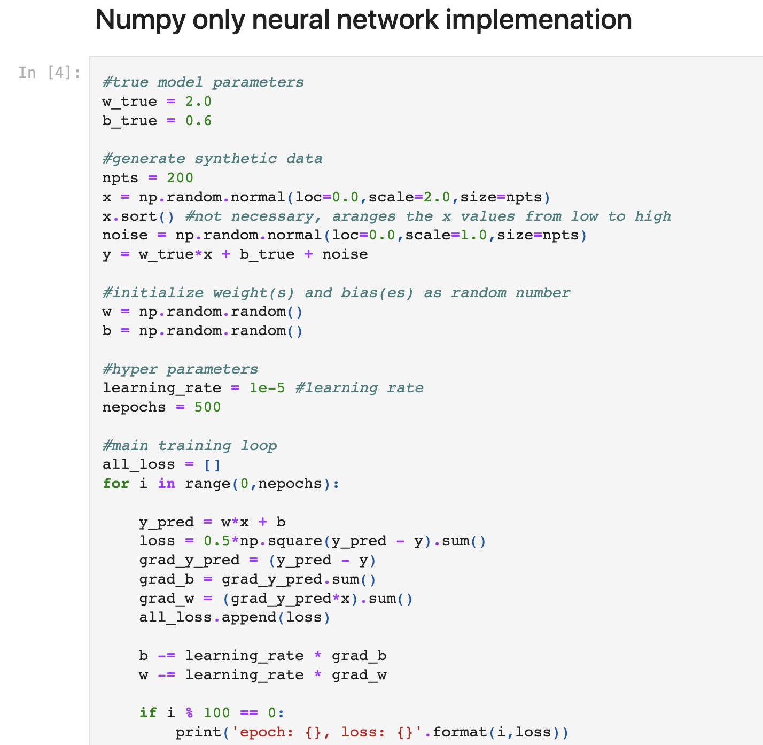

Slide 8
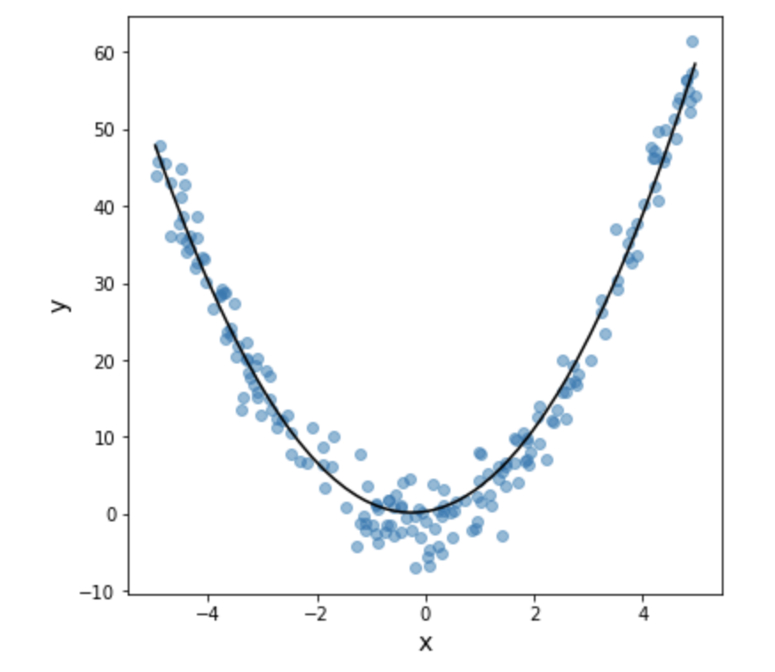
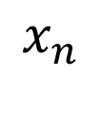

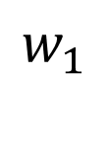
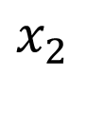

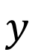

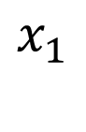
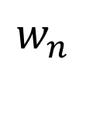
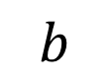
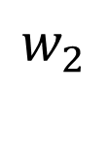
Linear regression with a neural network
$$y=w_{1}x_{1}+w_{2}x_{2}+⋅⋅⋅+w_{n}x_{n}+b$$
Input layer
Output layer
$$x_{1}$$
$$w_{1}$$
$$b$$
$$w_{2}$$
$$x_{2}$$
$$y$$
$$⋅$$
$$⋅$$
$$w_{n}$$
$$⋅$$
$$x_{n}$$

Slide 9

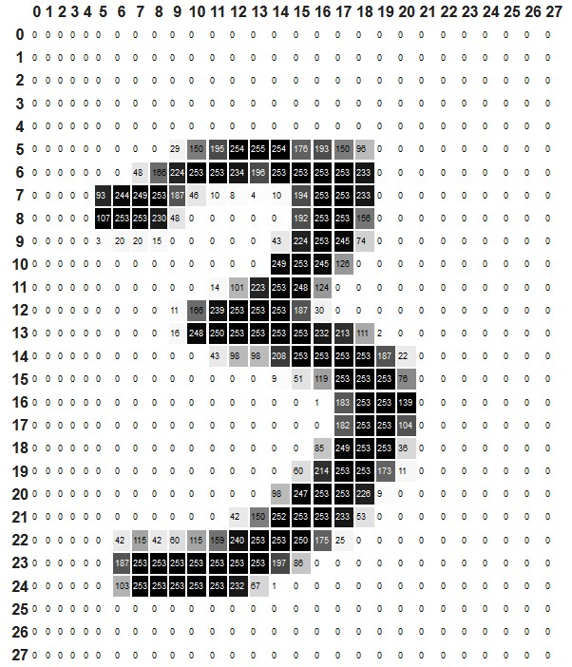
Image classification
MNIST (Modified National Institute of Standards and Technology)
784 total pixels

Slide 10
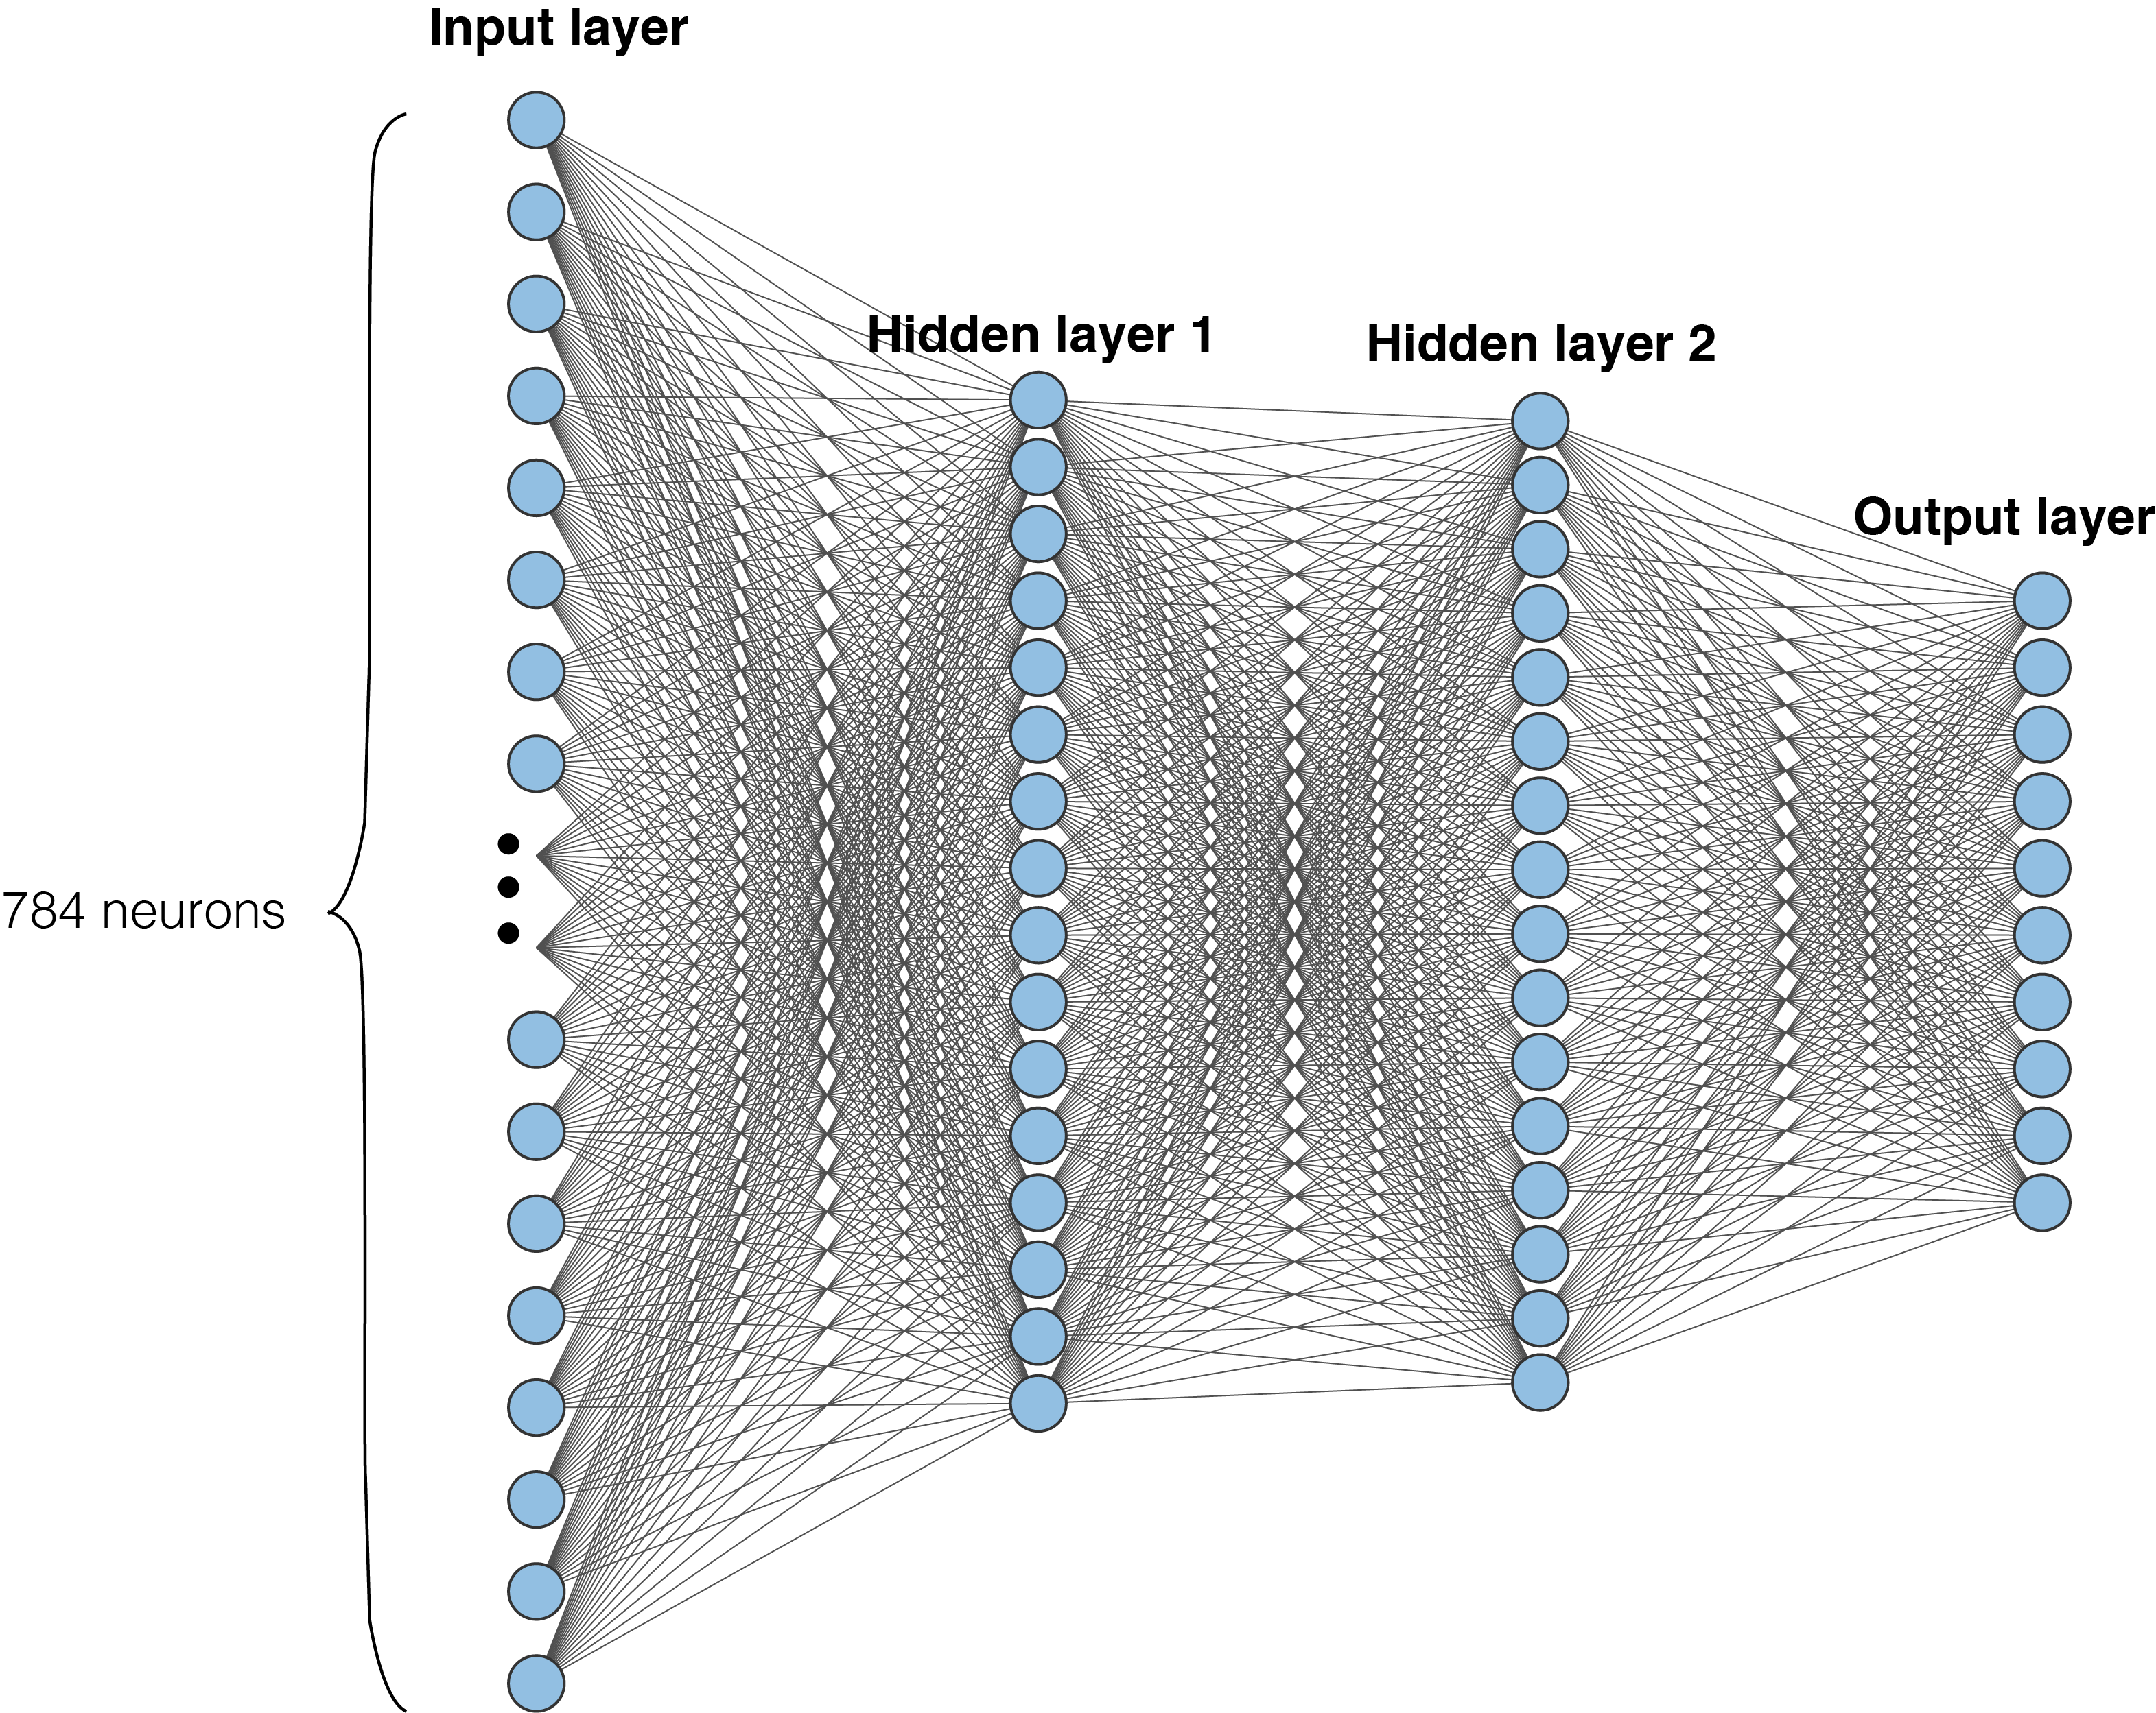
Multi-layer perceptrons (fully-connected networks)
Fully connected layers
$$y=w_{1}x_{1}+w_{2}x_{2}+⋅⋅⋅+w_{n}x_{n}+b$$

Slide 11
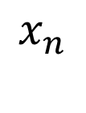

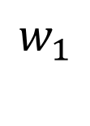
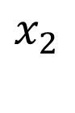

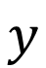

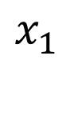
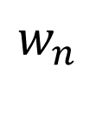
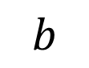
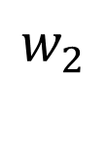
Activation functions
$$y=w_{1}x_{1}+w_{2}x_{2}+⋅⋅⋅+w_{n}x_{n}+b$$
$$x_{1}$$
$$w_{1}$$
$$b$$
$$w_{2}$$
$$x_{2}$$
$$y$$
$$⋅$$
$$⋅$$
$$w_{n}$$
$$⋅$$
$$x_{n}$$
Without a non-linear step, this can only learn linear models!

Slide 12




Activation functions
$$y=w_{1}x_{1}+w_{2}x_{2}+⋅⋅⋅+w_{n}x_{n}+b$$
$$y={A(w}_{1}x_{1}+w_{2}x_{2}+⋅⋅⋅+w_{n}x_{n}+b)$$
$$x_{1}$$
$$w_{1}$$
$$b$$
$$w_{2}$$
$$x_{2}$$
$$y$$
$$⋅$$
$$⋅$$
$$w_{n}$$
$$⋅$$
$$x_{n}$$

Slide 13
MLP with non-linear activations
ReLU activations
ReLU activations
This can learn complex non-linear models

Slide 14

Why are fully-connected networks not good enough?
1000 pixels
1 million neurons
1000 pixels

Slide 15
Convolutional neural networks (CNNs)
Reduce the number of parameters
Recognize patterns any where in an image
(i.e., positionally invariant)

Slide 16

Convolutional neural networks (CNNs)

Slide 17

Convolutional layers

Slide 18

Convolutional layers
Input
Filter / kernel (2x2)
Output
0
1
2
0
1
3
4
5
2
3
6
7
8
size = (input width – kernel size) / stride + 1

Slide 19
Convolutional layers
Input
Filter / kernel (2x2)
Output
0
1
2
0
1
19
3
4
5
2
3
6
7
8
size = (input width – kernel size) / stride + 1

Slide 20
Convolutional layers
Input
Filter / kernel (2x2)
Output
0
1
2
0
1
19
25
3
4
5
2
3
6
7
8
size = (input width – kernel size) / stride + 1

Slide 21
Convolutional layers
Input
Filter / kernel (2x2)
Output
0
1
2
0
1
19
25
3
4
5
2
3
37
6
7
8
size = (input width – kernel size) / stride + 1

Slide 22
Convolutional layers
Input
Filter / kernel (2x2)
Output
0
1
2
0
1
19
25
3
4
5
2
3
37
43
6
7
8
size = (input width – kernel size) / stride + 1

Slide 23

Max pooling
max-pooling with 2x2 filter and stride 2
Downsampling to reduce the number of parameters
Only the element with the largest value is selected
a 2 x 2 max pooling layer with stride 2 will reduce each dimension of the input layer by a factor of 2

Slide 24

Dropout
Randomly ignore neurons to reduce the number of connections
Acts as a form of regularization to avoid over-fitting the data

Slide 25
Convolutional neural networks (CNNs)

Slide 26


Local Distance Earthquake/Explosion Source Discrimination
Explosions are a poor source of S-waves
How confidently can we discriminate between earthquakes and explosions at the ‘station level’ and the ‘event level’?
Can machine learning-based approaches improve source discrimination over conventional approaches?

Slide 27


Conventional discrimination (P/S ratio)

Slide 28



Use labeled data from the Utah Seismic Network to train a neural network to identify earthquakes and quarry blasts
Goal-
Explore whether NN’s can match or exceed classification accuracy of trained analysts
Build a NN that could be used in near real time for event classification

Slide 29

Network design
Included 103,944 signals from 13,313 analyst labeled events
46% quarry blasts, 54% earthquakes
Divided data in 80% training, 10% validation, 10% testing
Tested 2 Networks
Recurrent Network (Long Short Term Memory)
Convolutional NN

Slide 30

Network accuracy
Both network designs give > 95% accuracy at the station level
3 channel data improves station level accuracy modestly (~1.5%) over single channel data
Event level (Network level) accuracy is > 99%
The majority of the events that the network mis-classified (84/167), were due to label errors by the analysts!

Slide 31

Which parts of the spectrogram are most important for decision making?

